Slide 1

Mark McInturff
Advanced Techniques to Supercharge PowerShell PowerCLI Automation

Slide 2

Introduction & Background
5 VCP Certifications
VCAP 6.5 2020
Wrote Powershell replacement of RvTools
Thousands of Powershell automations since 2009
Mark McInturff
Kyndryl Architect in Data Management and AI Services

Slide 3
Powershell/PowerCLI Automation Examples
Scheduled Tasks or Cron Jobs
Network Scan
Reporting
Discovery
Provisioning
Migration

Slide 4
Standard PowerCLI
Get-VM
Get-Cluster
Get-Datacenter
Get-Snapshot
Get-Datastore
Get-VirtualPortGroup
+ 355 more Cmdlets

Slide 5
SUPERCHARGED PowerCLI
Standard | Supercharged
Get-VM | Get-View -ViewType VirtualMachine -Property Name
Get-Cluster | Get-View -ViewType ClusterResource
Get-Datacenter | Get-View -ViewType Datacenter
Get-Datastore | Get-View -ViewType Datastore
Get-VirtualPortGroup | Get-View -ViewType Network
Get-Snapshot | Get-View -ViewType VirtualMachine -Property Snapshot | Where-Object Snapshot

Slide 6
SUPERCHARGED PowerCLI: Count Snapshots
Cmdlet Slow
Get-View Fast
Get-Vm | Get-Snapshot
Get-View -ViewType VirtualMachine -Property Snapshot
15 minutes against against 11k VM's
1 second against 11k VM's

Slide 7
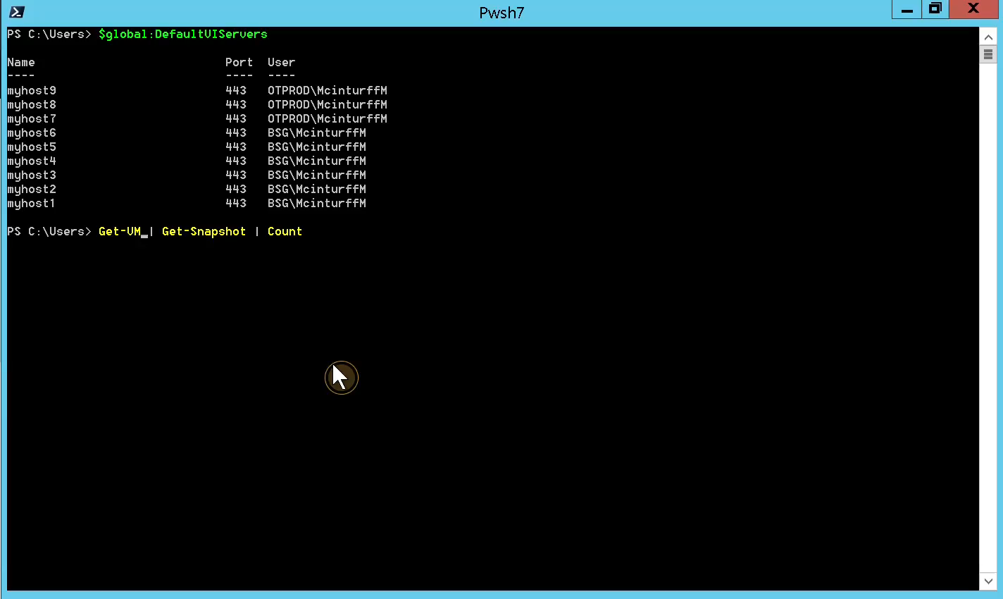
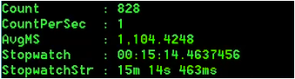

Demo: Get-Vm | Get-Snapshot
20,000% x Speed

Slide 8
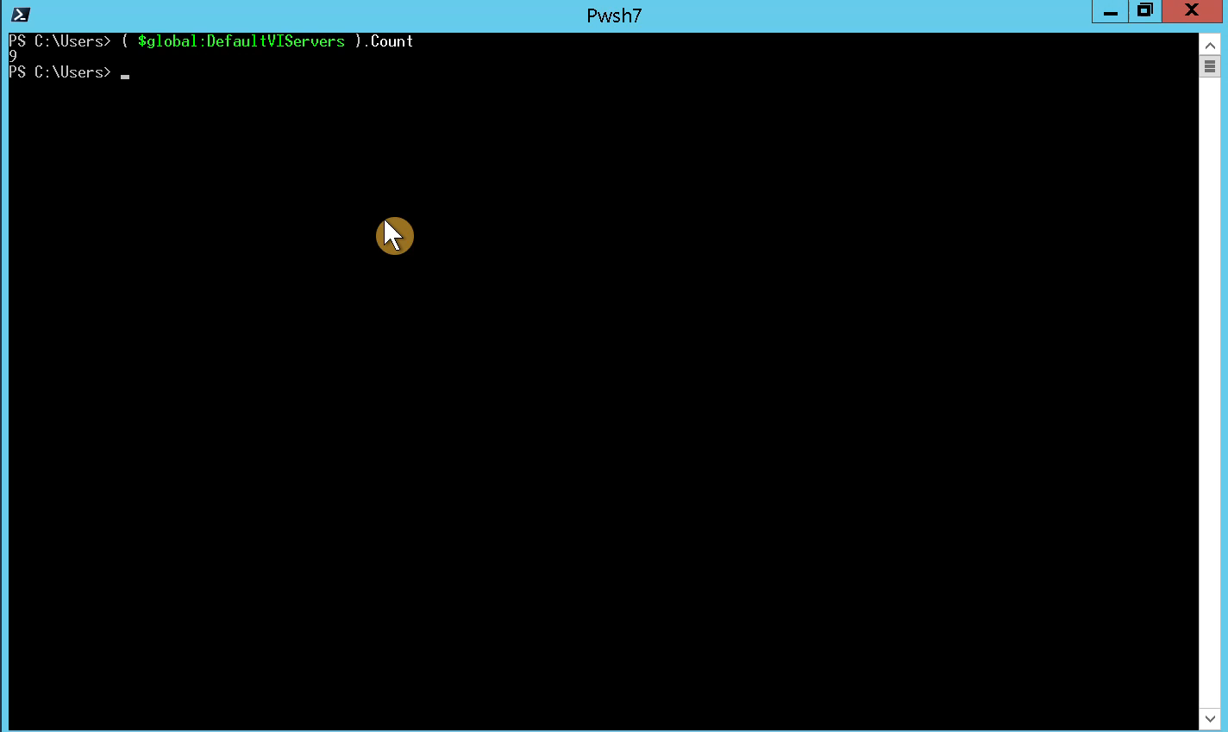
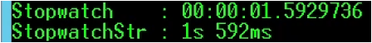
Demo: Get-View -ViewType VirtualMachine

Slide 9
Get-view -Property param truncates attributes for faster return
# Returns only the Name property of VirtualMachine
Get-View -ViewType VirtualMachine -Property Name
# Returns Name + Snapshot property VirtualMachine
Get-View -ViewType VirtualMachine -Property Name, Snapshot

Slide 10
Get-view -Property param truncates attributes for faster return
# Returns only the Name property of VirtualMachine
Get-View -ViewType VirtualMachine -Property Name
# Returns Name + Snapshot property VirtualMachine
Get-View -ViewType VirtualMachine -Property Name, Snapshot

Slide 11
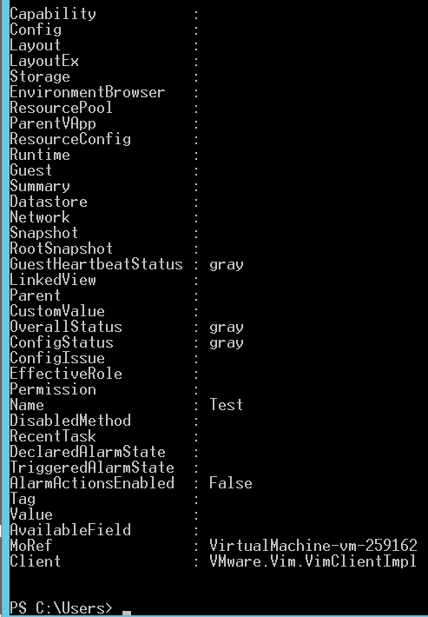
Get-View -Property Name
-Property parameter acts like a SPEED filter
This example Returns Only the Name (very fast)
Most of the Attributes (capability, config, layout, etc…)on the right can be named
-Property may have 1 or many named properties

Slide 12
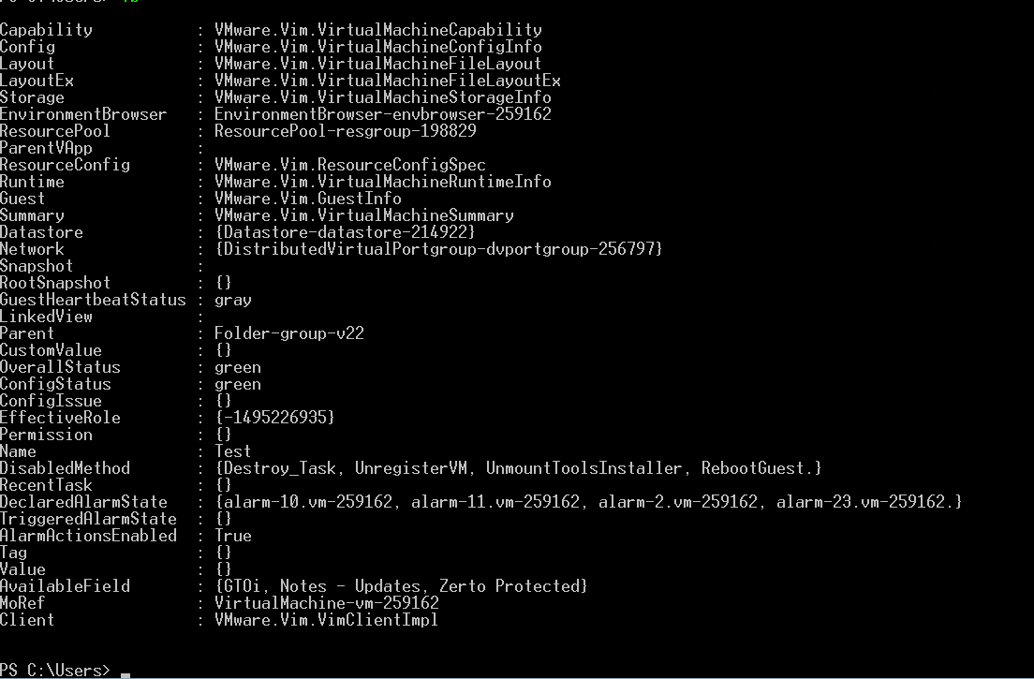
Get-View -ViewType Virtual Machine (no -Property)
Returns All properties
-Property * (implied)
Slower .. but might speedup can boost with Foreach-Object -Parallel

Slide 13
SUPERCHARGED with PWSH Core Parallel Process
$objects |
Foreach-Object -ThrottleLimit 20 -Parallel { # do something in parallel groups of 20 }
If -ThrottleLimit not explicit, the default is 5

Slide 14
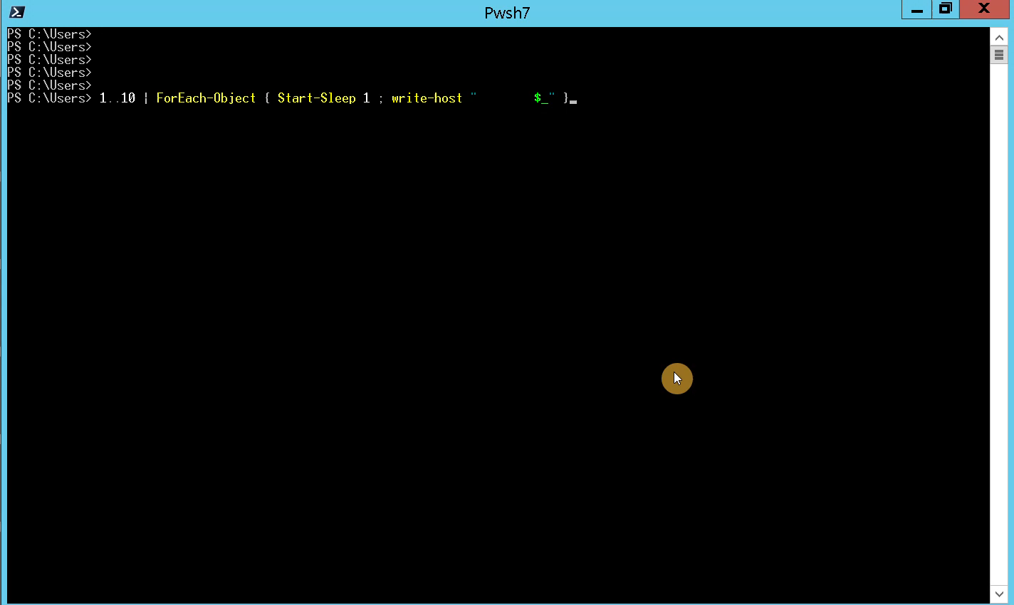
PWSH Core without Parallel Process
# Example 1: No Parallel
1..10 | ForEach-Object { Start-Sleep 1 ; write-host $_ }
# How long does Example 1 take?

Slide 15
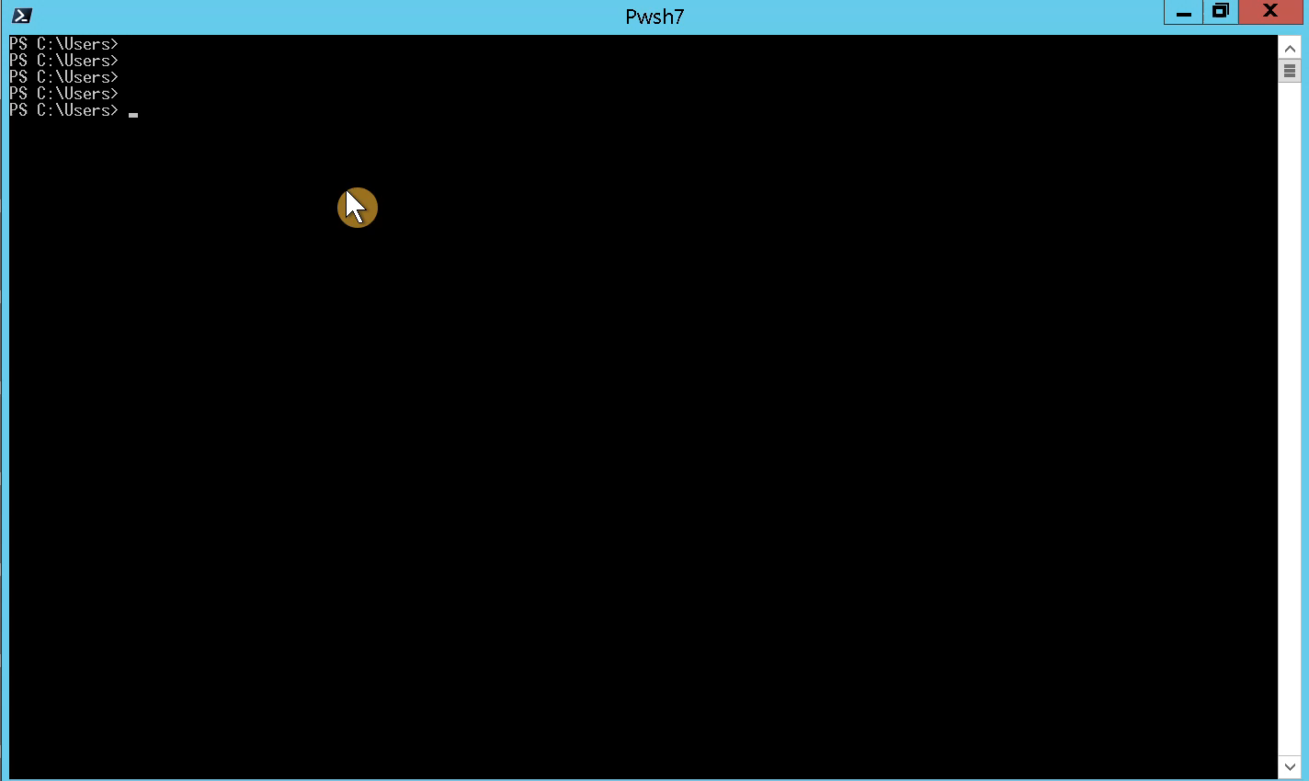
SUPERCHARGED with PWSH Core Parallel Process
# Example 2
1..10 | ForEach-Object -ThrottleLimit 10 -Parallel { Start-Sleep 1 ; write-host $_ }
# How long does it take?

Slide 16
Play with me LIVE DEMO PWSH Core Foreach-Object -Parallel Process
SLEEP 1 or 5 or 100 seconds to simulate an algorithm of many steps
Play with ThrottleLimit
Measure-Command { 1..1000 | ForEach-Object -Throttle 500 -Parallel { sleep 1 ; $_ } }
code samples github.com/RaysCars/vmug2023

Slide 17
SUPERCHARGED Parallel Process - Get VMhosts FAST
#Get Hosts returning only name
Get-View -ViewType HostSystem -Property Name | #Pipe to parallel process for loop
Foreach-Object -ThrottleLimit 30 -Parallel { Get-View $PsItem.MoRef }

Slide 18
When to use Foreach-object -Parallel?
ScriptBlocks that require more than 1 or 2 seconds to process
Parallel process may require up to 2 seconds to instantiate
ScriptBlocks{} that already execute less than 1 seconds will execute SLOWER in Parallel

Slide 19
Get-View MoREF = Managed Object Reference
MoREF's are used by vSphere Automation API's to refer to managed Objects
MoREF's are unique to each vCenter instance
99% of Get-View objects possess a MoREF
Get-View $obj.Moref any object

Slide 20
Arrays vs Hashtables for lookups
Array
Hashtable
Arrays are easy, but slow
Hashtables require a little setup, but fast
$vmList = Get-View -ViewType -ViewType VirtualMachine
$vmHashTable = @{}
Get-View -ViewType -ViewType VirtualMachine | ForEach-Object { $vmHashTable.Add($PSItem.MoRef, $PSItem }

Slide 21
Arrays vs Hashtables lookup for 11,500 VM's
Array
Hashtable
Slower
Faster
$vmList = Get-View -ViewType -ViewType VirtualMachine
$vmHashTable = @{}
Get-View -ViewType -ViewType VirtualMachine | ForEach-Object { $vmHashTable.Add($PSItem.MoRef, $PSItem }

Slide 22
Arrays vs Hashtables lookup for 11,500 VM's
Array Lookup
Hashtable Lookup
56ms
0.13ms
$vmList | Where-object Moref -eq "VirtualMachine-vm259162"
$vmHashTable["VirtualMachine-vm259162"]
430x Faster

Slide 23
Fast HashTables
$vmHashTable = @{}
# or
$vmHashTable = [hashtable]::new()
Get-View -ViewType -ViewType VirtualMachine | ForEach-Object {
$vmHashTable.Add( $PSItem.MoRef , $PSItem )
}

Slide 24
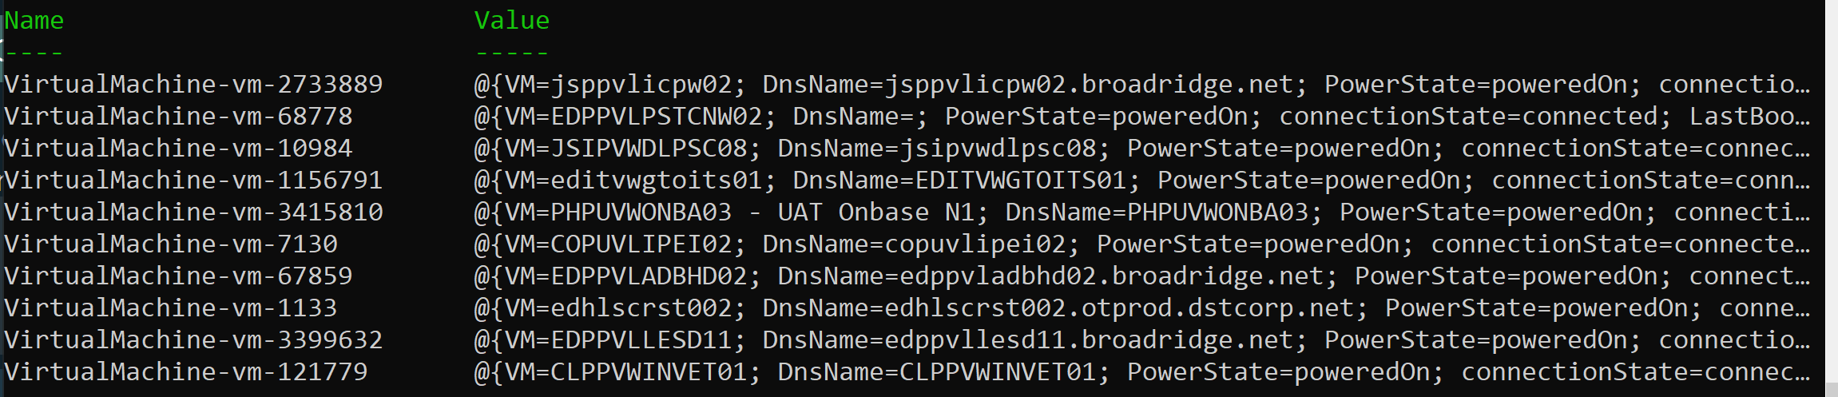
Fast HashTables
Contain two properties:
Name - String or Integer
Value - Any Powershell Object

Slide 25
Summary to Supercharge PowerCLI
Get-View
Foreach-Object Parallel
Use Hashtables for Lookups
Get Inventory Super Fast
Speedup slow Scriptblocks
430x faster than arrays

Slide 26

Mark McInturff
files at github.com/RaysCars/vmug2023
Advanced Techniques to Supercharge PowerShell PowerCLI Automation

